Slide 1
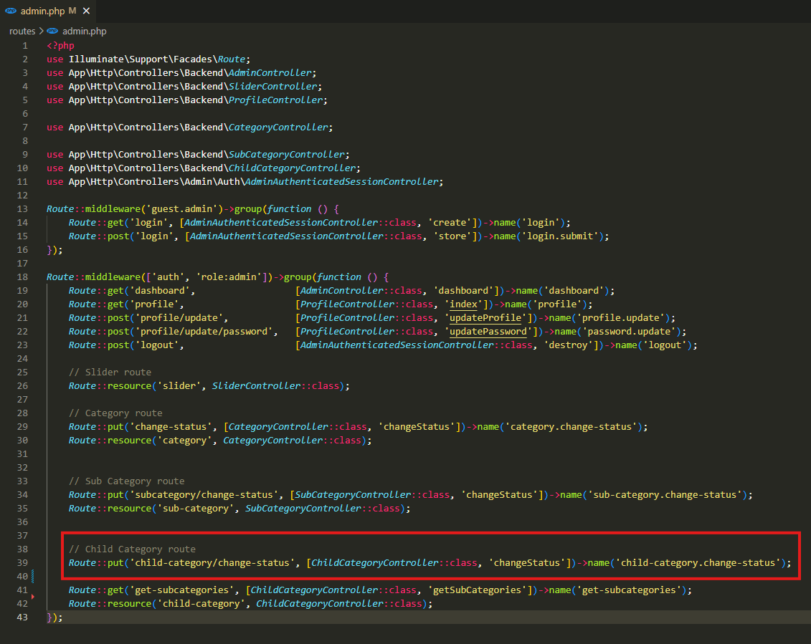
routes\admin.php

Slide 2
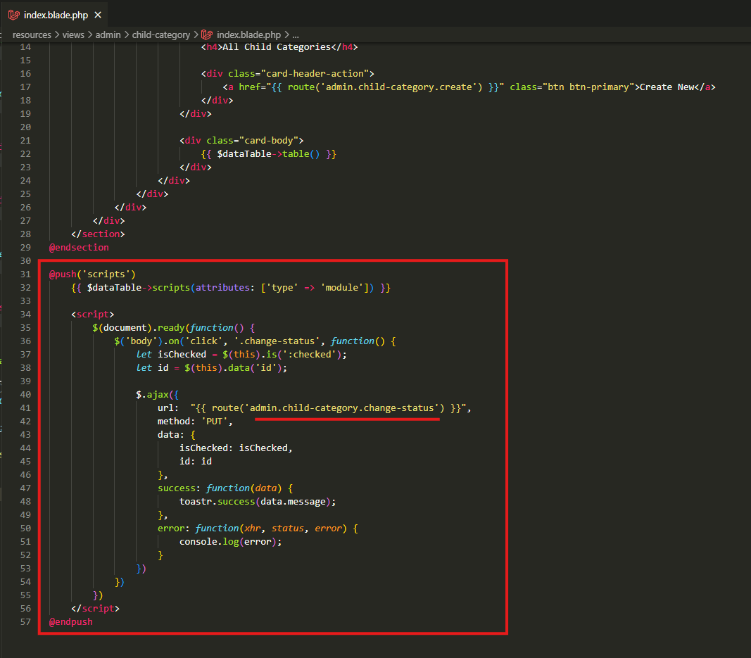
resources\views\admin\child-category\index.blade.php

Slide 3
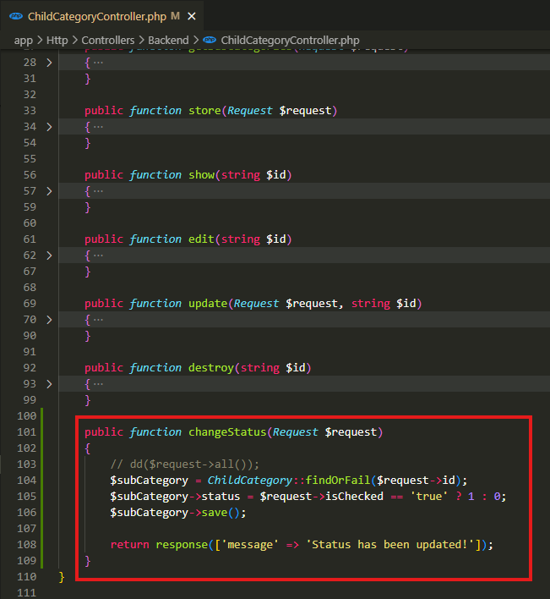
app\Http\Controllers\Backend\ChildCategoryController.php

Slide 4
.

